Slide 1
Thinking Like a Computer
ENV 762
Initially prepared by Ethan Addicott in 2019
Edited by Matthew Gordon in 2020
Edited by Andie Creel in 2023

Slide 2
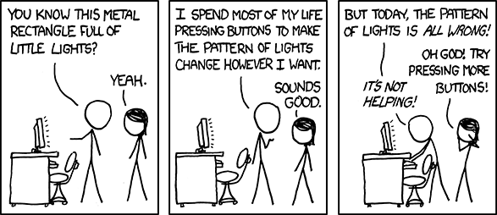
How my parents think computers work:

Slide 3
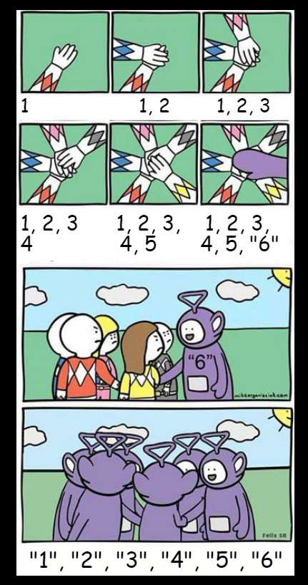
By the end of this week, this will make you laugh!

Slide 4
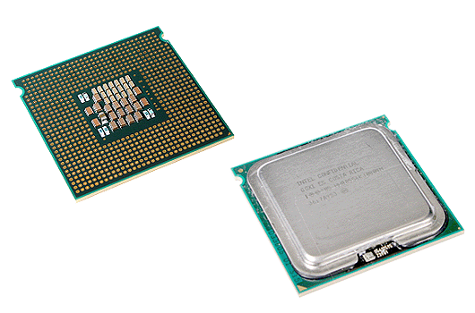
What is programming?
It is the language that your computer speaks
Languages (R) vs Applications (R studio)
When you download R you are downloading a translator (compiler) that translates R into “languages” that your computer knows
Rstudio is an application (like Word or Excel) that makes it easy to write code in R and see the results

Slide 5
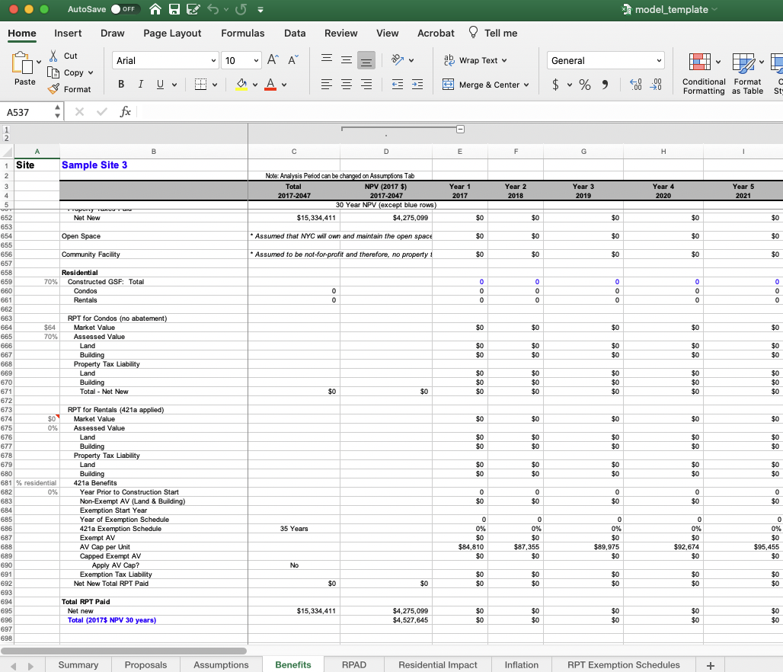
Why not just use Excel?
Advantages of R
Speed and memory
Replicability and Reproducibility
Capabilities
Open Source and Free!
Disadvantages
Learning curve

Slide 6
Coding collaboratively
R is open source – that means that anyone can develop code and share it with the world
A package is R code that someone has created and shared for anyone to download
For example the tidyverse package contains a group of functions that makes working with data much easier
Install.packages(“tidyverse”) - first time - and then library(tidyverse)

Slide 7




Coding collaboratively: GitHub
A repository on GitHub (or a branch of one)
Edit code on your local machine (make ‘commits’)
Push changes up to the cloud
Pull code to your local machine

Slide 8
Programming as a language (like Math!)
Both communicate abstract ideas via a formal language with a grammar
Workflow:
Pseudocode (Ideas stage)
Program/Code (in programming language)
Debug (Fix grammar + Edit)

Slide 9

How do you brew a cup of coffee? Take 3 minutes to write instructions for how to brew a cup of coffee

Slide 10
How do you brew a cup of coffee? Switch instructions with a partner. Have them “compile” your code. Do you find any bugs? (5 min)

Slide 11

How do you play Rock, Paper, Scissors? Take 5 minutes to write instructions for how to play. You will need 3 cases.

Slide 12
How do you play Rock, Paper, Scissors? Switch partner. Play by the rules they just gave you. Can you cheat??

Slide 13

CONRATULATIONS!
You’ve just written a program in pseudo-code.
How would you play best two out of three?

Slide 14
Pseudocode for Rock, Paper, Scissors

Slide 15
R code for Rock, Paper, Scissors

Slide 16
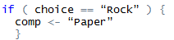
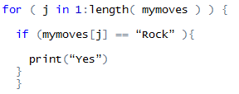
Fundamental Computing Tasks
Store things (numbers, strings, ...)
Make collections of things (my last two turns)
Test things (Did I choose Rock?)
Repeat things (Did I ever choose Rock?)

Slide 17
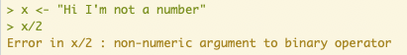
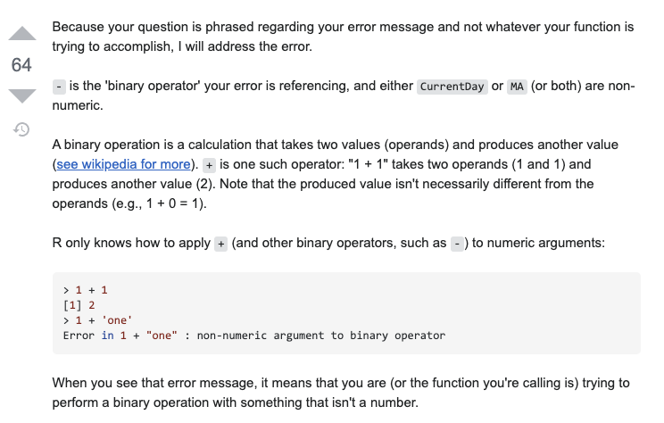
What if you get stuck?
#1. Use Google and Stack overflow:

Slide 18
What if you get stuck?
#2. Ask ChatGPT
“Pretend you are an expert in R coding.”
Use this same chat for all your questions.
You can ask it questions in words
You can paste in your code and error, and it’ll help you debug
Use with caution…
ChatGPT is most valuable when helping you solve HARD problems.
To get to those hard problems, you need to be able to do easy problems yourself.
Notes:
remove any item that equals 0 in a vector

Slide 19
What if you get stuck?
#3. Create a minimum reproducible example
https://stackoverflow.com/help/minimal-reproducible-example
Don’t:
Copy and paste your entire code and tell me its not working
Do:
Figure out which line of code is causing the error
Try your code on simpler objects to see if it works
Tell me what you’ve already tried
What is the minimum amount of code and data that it would take a stranger to replicate your problem?

Slide 20
Style guide: http://adv-r.had.co.nz/Style.html
“Good coding style is like using correct punctuation. You can manage without it, butitsuremakesthingseasiertoread.”
Rstudio will handle some stuff for you
Curly braces
Indentation
Other stuff is up to you
Naming objects and files
Commenting code

Slide 21
Other best practices for data management
The file structure can make any project so much better (especially if you are collaborating)
Project Management by Matt Wibbenmyer
Code and Data for the Social Sciences: A Practitioner’s Guide by Matthew Gentzkow and Jesse M. Shapiro

Slide 22
Homework
Install R and R studio
Set up a GitHub account
Next class we will
Branch and Pull the GitHub repository to our local computers
Work through an introduction script
Work on pset (if time)
Notes:
Go to https://github.com/Yale-YSE-AMES/R_intro
Follow instructions on readme file

Slide 23
More Exercises
Create a 5x5 matrix where the diagonal elements are all 7 and the off-diagonal elements are 0s.
Generate the sequence ½, ¼, 1/8, … 1/100 in R.
Using a loop, calculate 1/1 -1/2 + 1/3 – ¼ + ... + 1/29 – 1/30.
Simulate the volume of water in a cattle tank. The tank starts with 100L of water and gains 2L per day from rainfall. The cows drink 10% of the tank’s volume per day.
Graph the volume over time from question 4.

